Slide 1
Applied Machine Learning and Data Mining
Week 1: Introduction to Machine Learning and Data Mining
Dr. Alaa Mohasseb

Slide 2
This Week Learning Objectives
Learn the difference between Data mining (DM) and Machine learning (ML).
Identify the Importance of Data mining and Machine Learning.
Introduce to Jupyter Notebook and other Data Mining tools

Slide 3
Data, Info, Knowledge, Wisdom
Wisdom
Applied
Knowledge
Context
Information
Meaning
Data
Raw
Further Reading:
https://www.theifactory.com/news/gaining-wisdom-from-data/
https://www.ontotext.com/knowledgehub/fundamentals/dikw-pyramid/

Slide 4
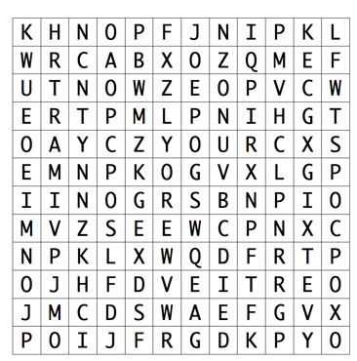
Example: Data
Data: is a collection of points with no discernible meaning.
Source: http://www.turninggrille.com/data-information-knowledge-wisdom/

Slide 5
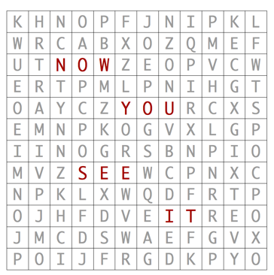
Example: Information
Information: is data in context.

Slide 6
Example: Knowledge
Knowledge: is information that has been assimilated in the mind.

Slide 7
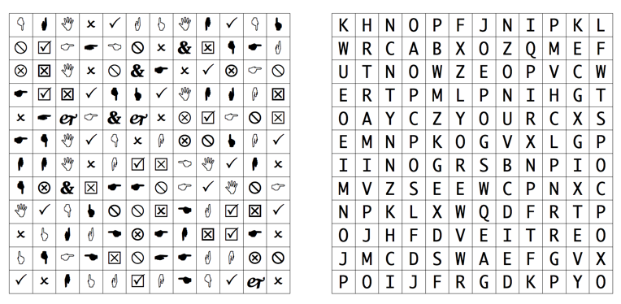
Example: wisdom
Wisdom: is the application of knowledge.

Slide 8
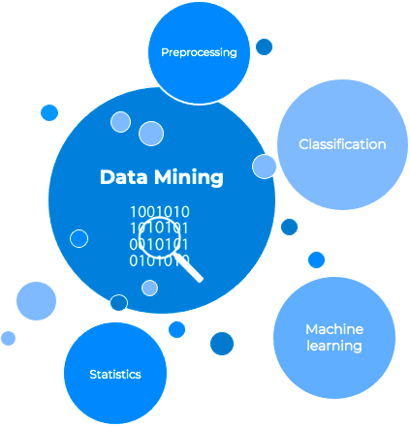
What is Data Mining?
The process of understanding and discovering new, previously unseen knowledge in the data.
Data mining tools, methodologies, and theories are used to reveal patterns in data.
Further Reading:
https://www.talend.com/resources/what-is-data-mining/
Notes:
For example, a store might use data mining to look at the buying habits of their customers. They might find that people who buy chips are also likely to buy salsa. This is a hidden pattern that they can use to make suggestions to customers, like "People who bought chips also bought salsa.

Slide 9
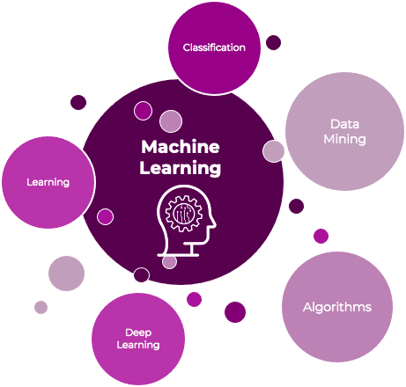
What is Machine Learning?
In summary, AI is a broader field that encompasses the development of intelligent systems, while ML is a subset of AI that focuses on teaching computers to learn from data. Data mining, on the other hand, is a specific technique used in AI and ML to extract insights and patterns from data. AI may include both ML and data mining as part of its toolkit to achieve its goal of creating intelligent systems.
Training a machine to classify emails as spam or not spam by analyzing a large dataset of emails.
In simple terms, think of AI as the big umbrella, ML as a part of AI focused on learning from data, data mining as a technique for finding insights, and deep learning as a specific kind of ML that uses deep neural networks for tasks like image and speech recognition
Machine learning is an application of artificial intelligence (AI).
Aim to develop algorithms that can learn from historical data and improve the system with experience.
Learning algorithm:
Supervised Learning
Unsupervised
Notes:
Machine learning is like teaching a computer to learn from examples, just like how you learn from experience. It's a way to make computers smarter by showing them lots of information and letting them figure things out on their own.
Here's a simple example: Let's say you want to teach a computer to recognize cats in pictures. You show it hundreds of pictures, some with cats and some without. The computer learns to look for patterns that are common in cat pictures, like pointy ears, whiskers, and furry tails. After seeing many examples, the computer gets better at spotting cats in new pictures.
So, machine learning is all about training computers to make predictions, recognize patterns, or solve problems based on the information they've learned from data. It's like teaching a computer to be a detective and find hidden clues in lots of pictures or numbers, which can be super helpful in various tasks like image recognition, language translation, and even self-driving cars

Slide 10
Machine Learning
How does machine learning work?
How is machine learning used?
What is the future of machine learning?

Slide 11
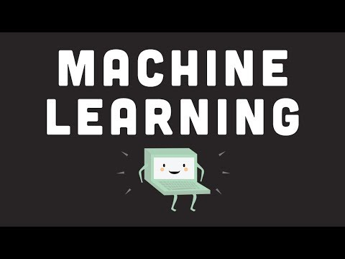
The following video will give you an overview of the evolution of machine learning and its impact on our daily life.

Slide 12
Why DM and ML is Important ?
Better Decision-Making
Data Analysis, Extraction and Interpretation
Performance Optimisation
Cost Reduction

Slide 13
Data Mining vs Machine Learning
Basis for Comparison | Data Mining | Machine Learning
Meaning | Extracting knowledge from a large amount of data | Introduce a new algorithm from data as well as past experience
Responsibility | Data mining is used to get the rules from the existing data. | Machine learning teaches the computer to learn and understand the given rules.
Origin | Traditional databases with unstructured data | Existing data as well as algorithms.
Implementation | We can develop our own models where we can use data mining techniques for | We can use machine learning algorithm in the decision tree, neural networks and some other area of artificial intelligence.
Nature | Involves human interference more towards manual. | Automated, once design self-implemented, no human effort
Application | used in cluster analysis | used in web search, spam filter, credit scoring, fraud detection, computer design
Techniques Involved | Data mining is more of research using methods like machine learning | Self-learned and trains system to do the intelligent task.
Scope | Applied in the limited area | Can be used in a vast area.
Further Reading: https://www.softwaretestinghelp.com/data-mining-vs-machine-learning-vs-ai/
Notes:
In simple terms, machine learning is more about using data to make predictions or automate decisions, while data mining is about discovering new, valuable information or patterns within data. Machine learning often uses data mining as a first step to gather insights and then applies those insights to specific tasks like predictions or recommendations.

Slide 14
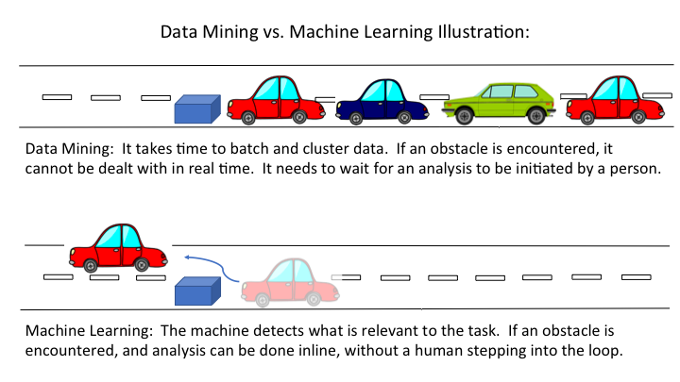
Example
source:https://www.guavus.com/artificial-intelligence-vs-machine-learning-vs-data-mining-101-whats-big-difference/

Slide 15
Software and tools
The main tools used for data mining, analysis and machine learning:
Python (Anaconda + Jupyter)
WEKA
Knime
In this Module Jupyter Notebook will be used

Slide 16

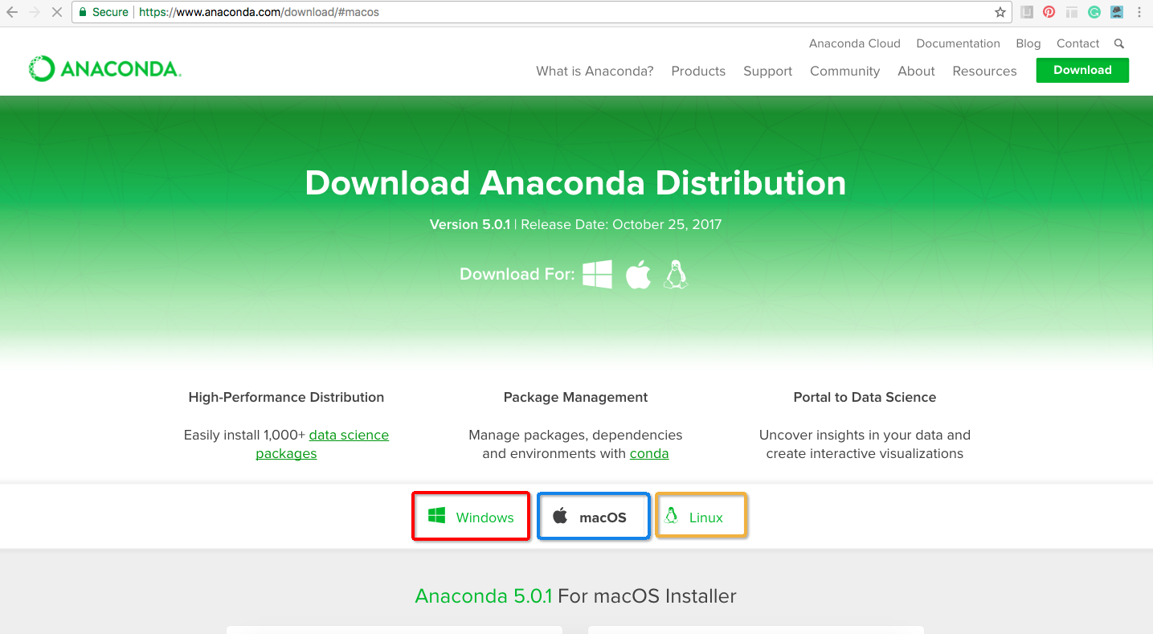
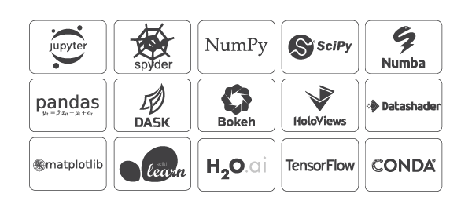
PYTHON
Anaconda
https://www.anaconda.com/distribution/
free and open-source
Python and R programming languages
Data science, machine learning applications

Slide 17

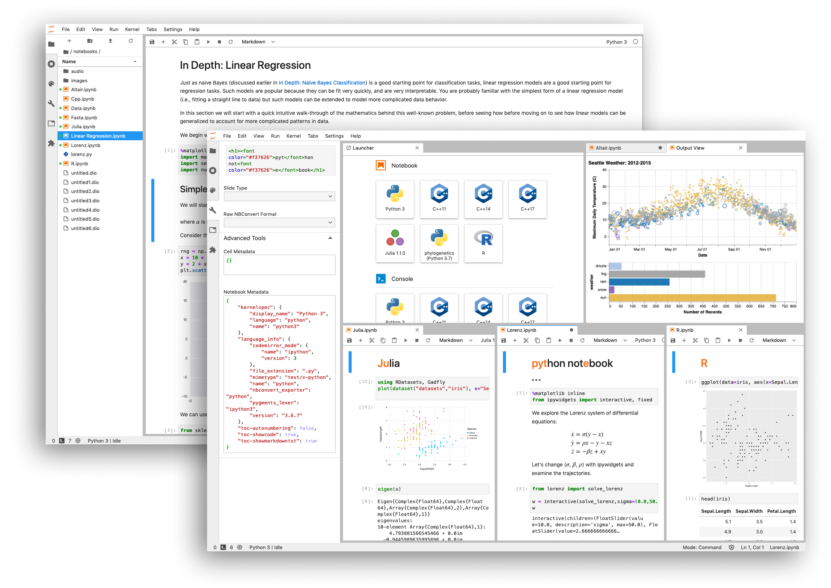
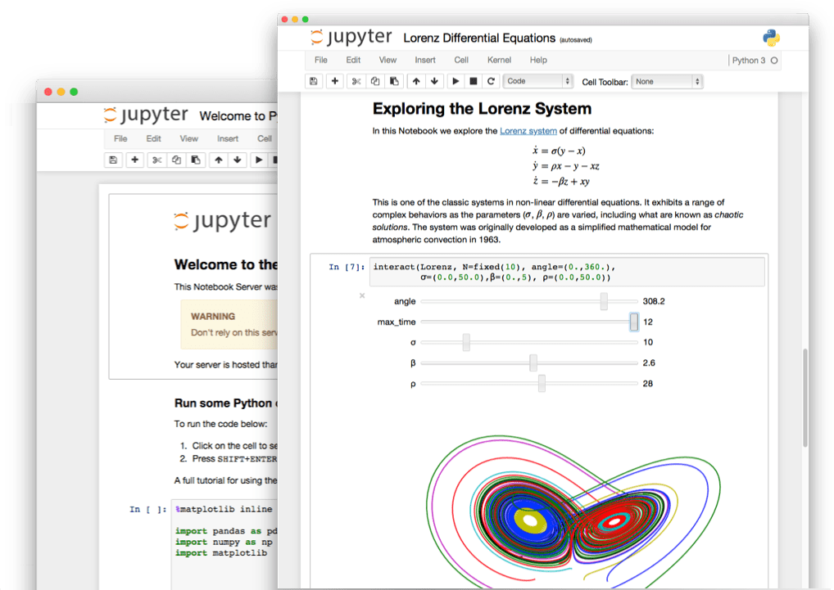
JUPYTER
Jupyter Notebook
https://jupyter.org/index.html
An open-source web application
Uses include:
data cleaning and transformation.
Numerical simulation.
Statistical modeling
Data visualization
Machine learning, and much more.

Slide 18
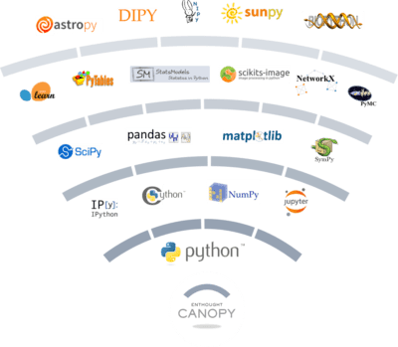
PYTHON LIBRARIES AND PACKAGES
Numpy
Pandas
Matplotlib
Scikit-Learn
Scipy

Slide 19

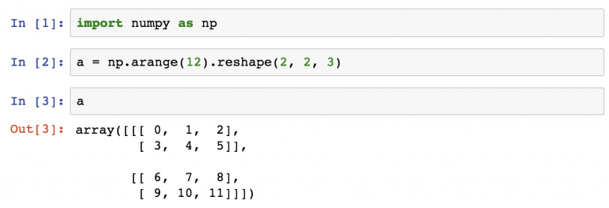
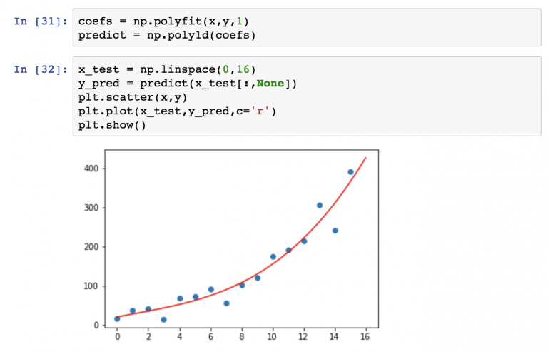
NUMPY
Website:
https://numpy.org/
https://docs.scipy.org/doc/numpy/reference/
library for the Python programming language.
Support large, multi-dimensional arrays and matrices.
Mathematical functions.
without NumPy you won’t be able to use Pandas, Matplotlib, Scipy or Scikit-Learn.

Slide 20

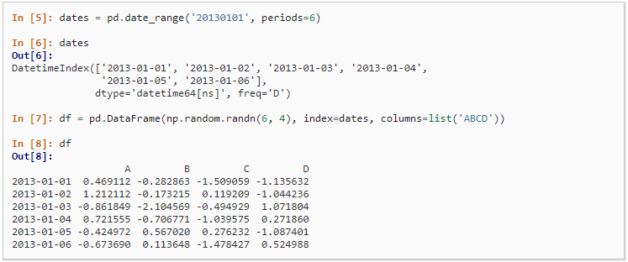
PANDAS
Website:
https://pandas.pydata.org/
https://pandas.pydata.org/pandas-docs/stable/
Pandas is used for data manipulation and analysis.
Data structures and operations for manipulating numerical tables and time series.
Pandas is the “SQL of Python”.
load data into data frames, select columns, filter for specific values, group by values, run functions (sum, mean, median, min, max, etc.), merge dataframes and create multidimensional data-tables.

Slide 21

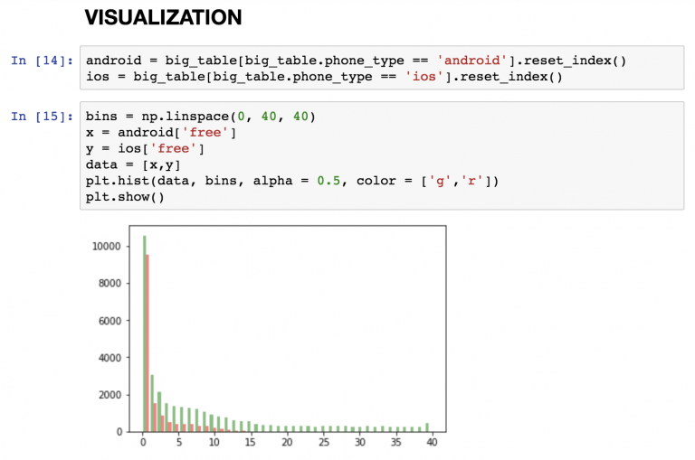
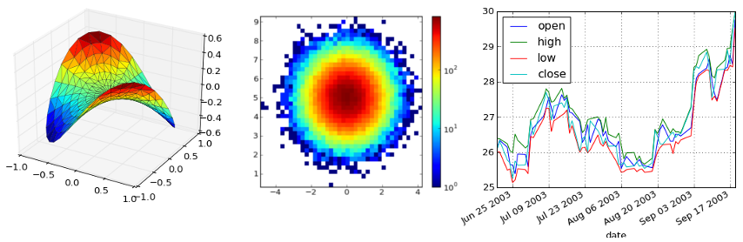
MATPLOTLIB
Website: https://matplotlib.org
Matplotlib is a plotting library for the Python programming language and its numerical mathematics extension NumPy.

Slide 22
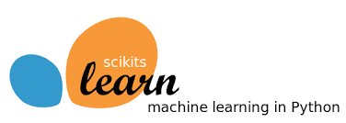

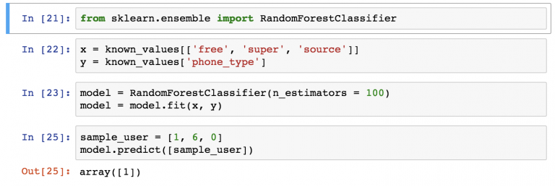
SCIKIT-LEARN
Website: https://scikit-learn.org/
Includes: regression methods, classification methods, and clustering, as well as model validation and model selection, dimensionality reduction and feature extraction.

Slide 23

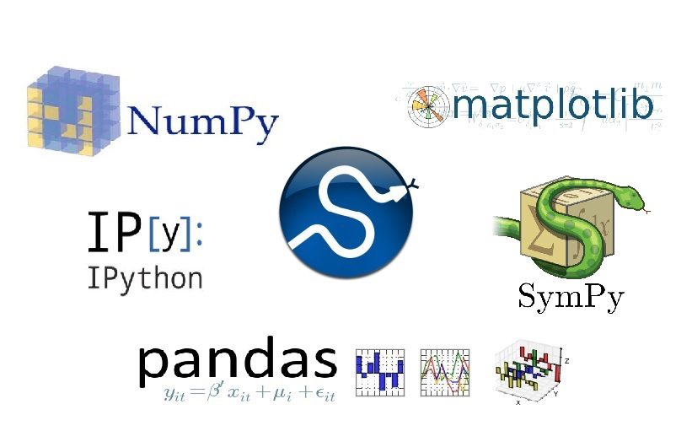
SCIPY
Website: https://www.scipy.org/
Scipy provides the core mathematical methods to do the complex machine learning processes in Scikit-learn.

Slide 24
Other ML/ DM Softwares

Slide 25

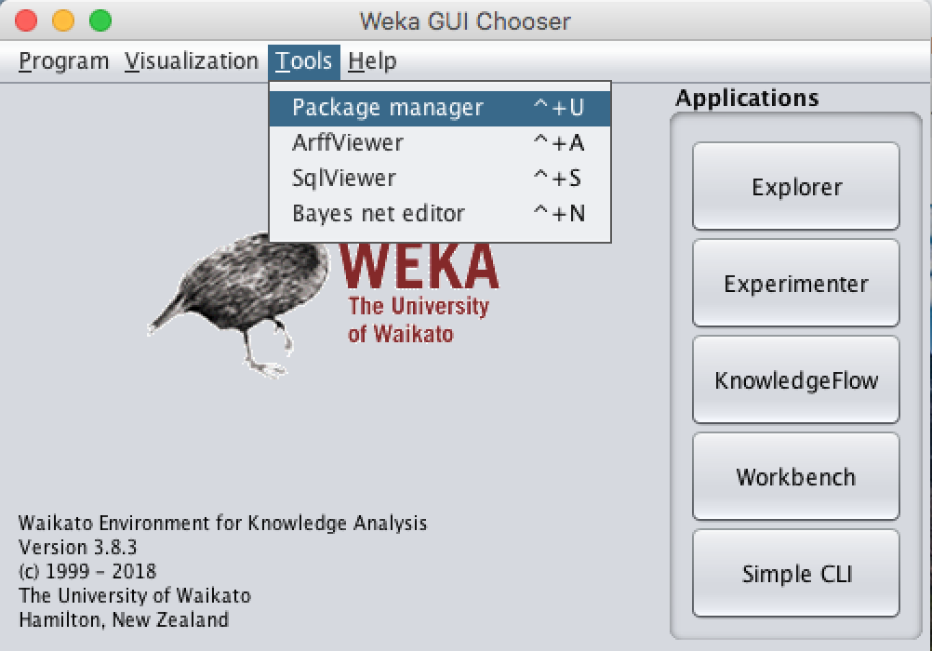
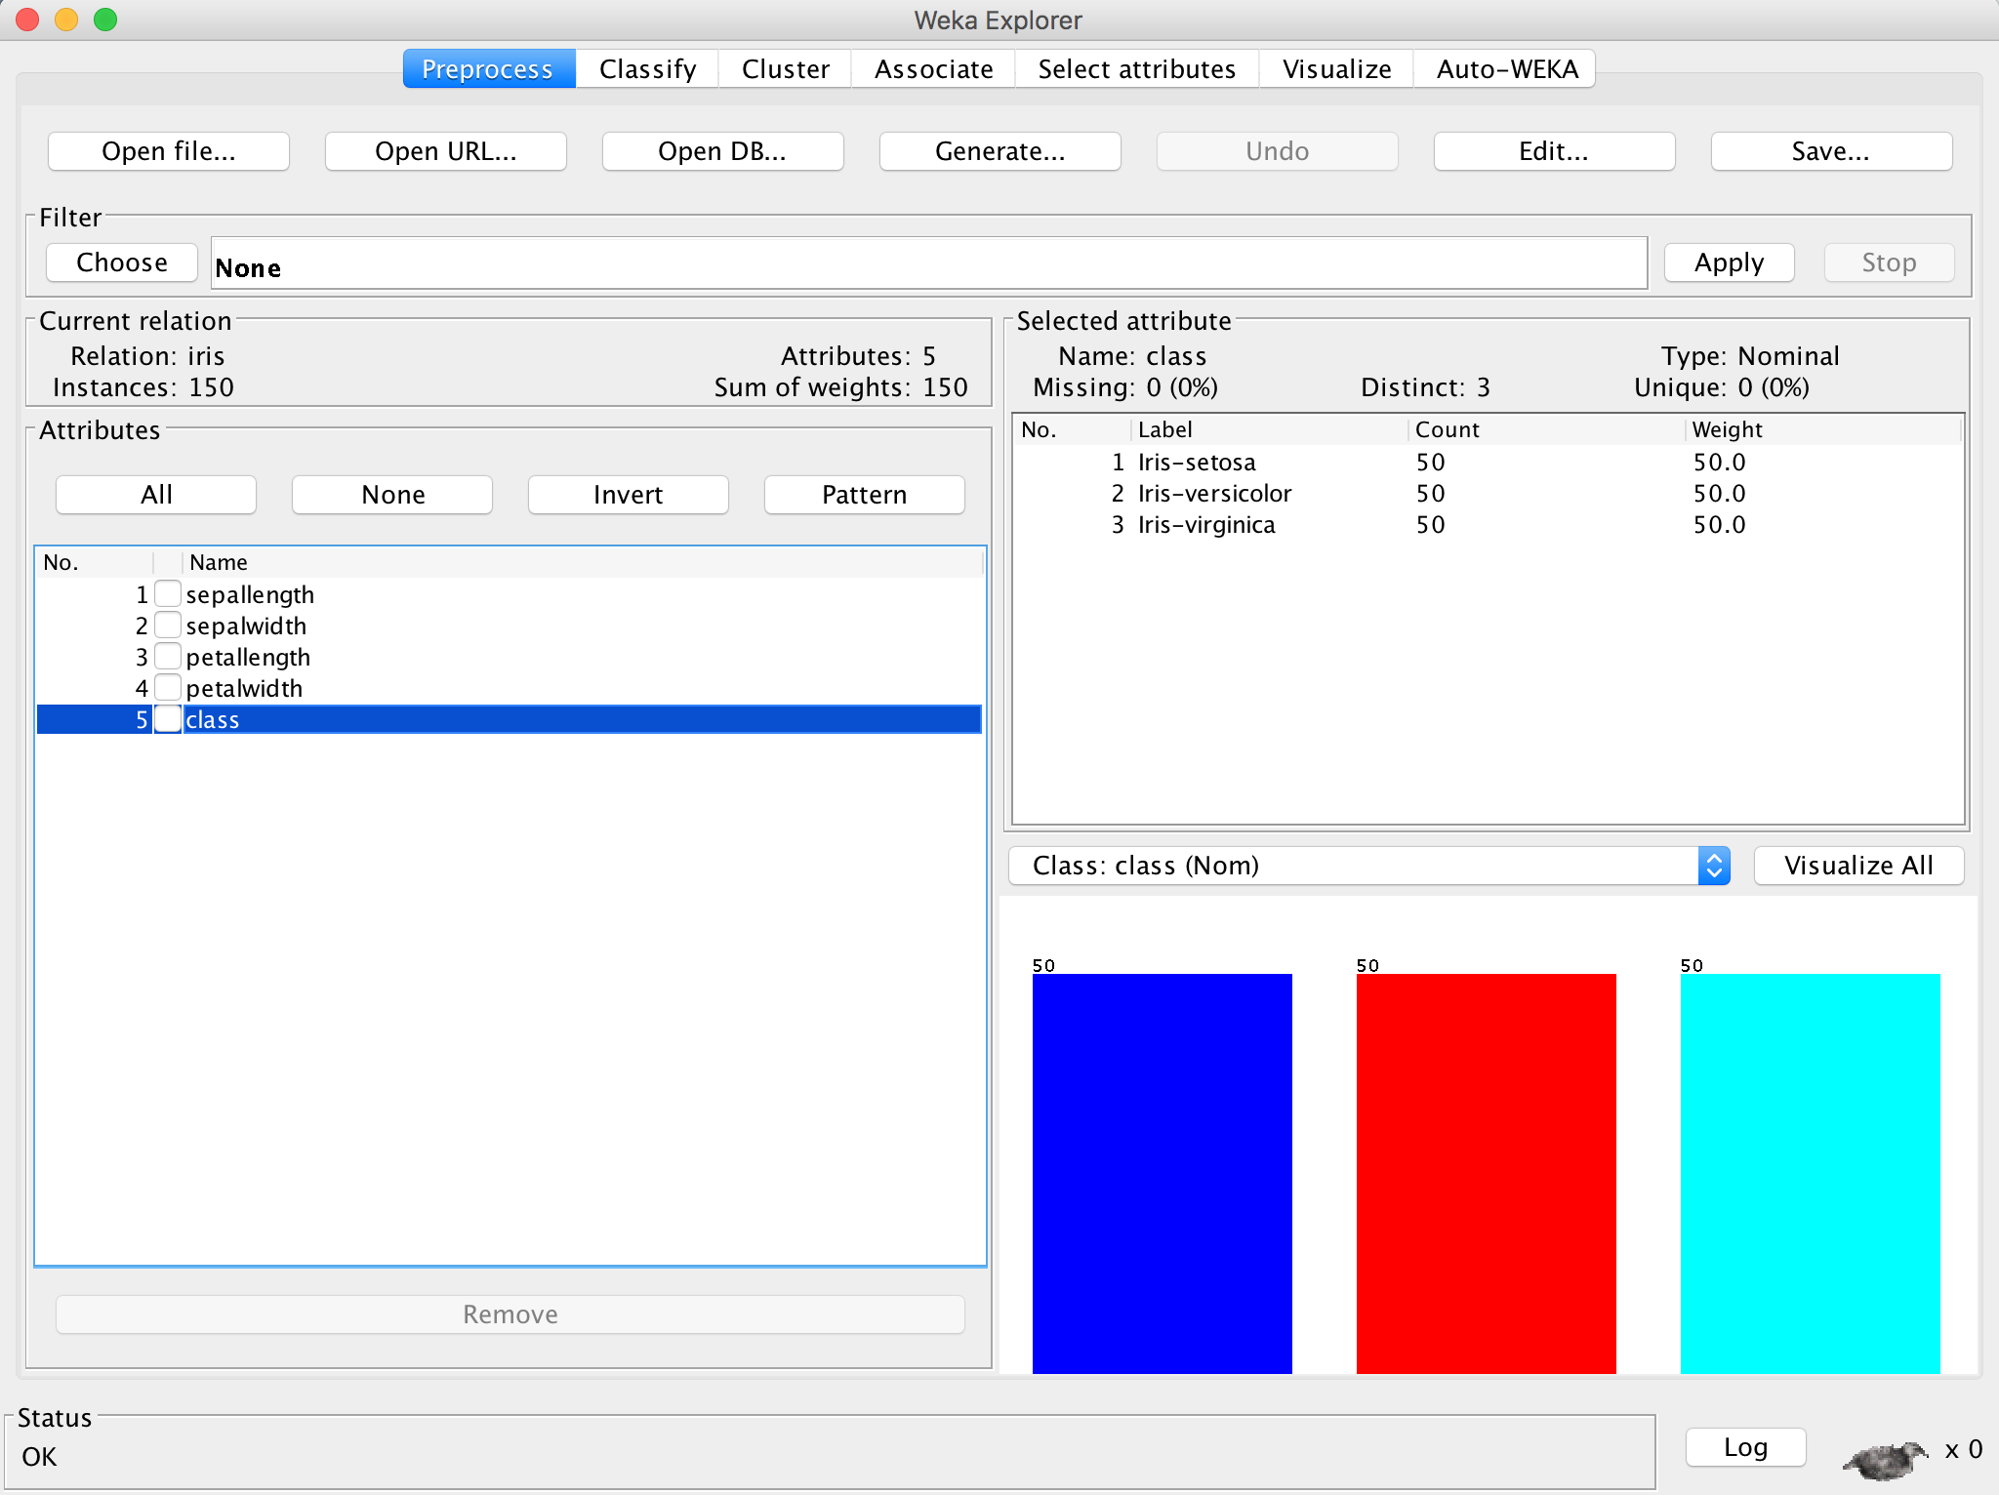
WEKA
Website: https://www.cs.waikato.ac.nz/~ml/weka/index.html
collection of machine learning algorithms for data mining tasks.
The algorithms can either be applied directly to a dataset or called from your own Java code.
Contains tools for data pre-processing, classification, regression, clustering, association rules, and visualization

Slide 26
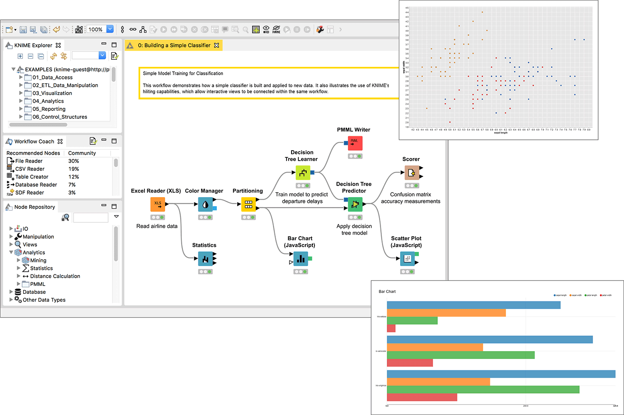

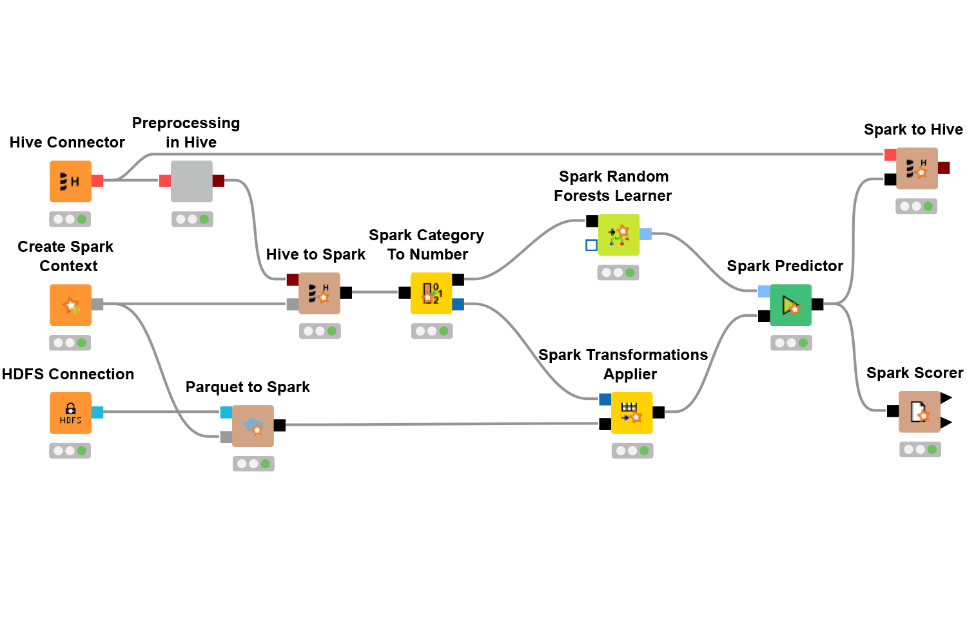
KNIME
Website: https://www.knime.com/
is a free and open-source data analytics, reporting and integration platform.
KNIME integrates various components for machine learning and data mining through its modular data pipelining concept.

Slide 27
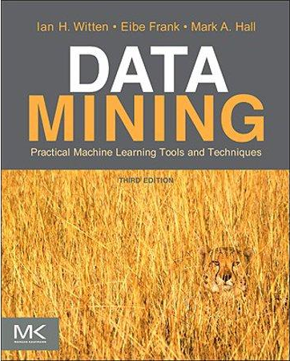
Reading for this week
Chapter 1:
1.1 Data Mining and Machine Learning
Machine Learning
Data Mining
1.2 Simple Examples: The Weather Problem and Others.
1.4 Machine Learning and Statistics
1.6 Data Mining and Ethics

